Slide 1
Fourier Series & Transform
IT 3105: Signals and Systems

Slide 2
Jean Baptiste Joseph Fourier
Jean Baptiste Joseph Fourier,a French mathematician and a physicist; was born in Auxerre, France.
He initialized Fourier series, Fourier transforms and their applications to problems of heat transfer and vibrations. The Fourier series, Fourier transforms and Fourier's Law are named in his honour.
Jean Baptiste Joseph Fourier, 21March1768– 16May1830

Slide 3
Fourier Series
Fourier series can be used to expand the periodic signal in terms of harmonics which are sinusoidal and orthogonal to each other.
Periodic signals can be continuous or discrete. For continuous signal CTFS and for discrete signal DTFS can be derived.
Fourier Transform, CTFT and DTFT is used to analyze non-periodic signal. FS and FT is used for analysis purposes.
Signals can be in form of square, sine or cosine. Again a square wave can be formed using infinite number of sine wave. Fourier series can be used to decomposed these composite signals.
For modeling any odd signal we can use sine terms. [sin (-x)= -sin(x)]
For modeling any even signal we can use cosine terms. [cos(-x) = cos(x)]

Slide 4
Dirichlet Condition
For any periodic signals we have to find “Dirichlet Condition” satisfied or not to prove the existence of Fourier series expansion.
Periodic signals can be analyzed by FS if the Dirichlet Condition are satisfied by any periodic signal then we can say FS exists for that signal.
Condition 1: Signals should have finite number of minima and maxima over the range of time period.
Condition 2: Signal should have finite numbers of discontinuities over the range of time period.
Condition 3: Signals should be absolutely integrable over the range of time period.

Slide 5
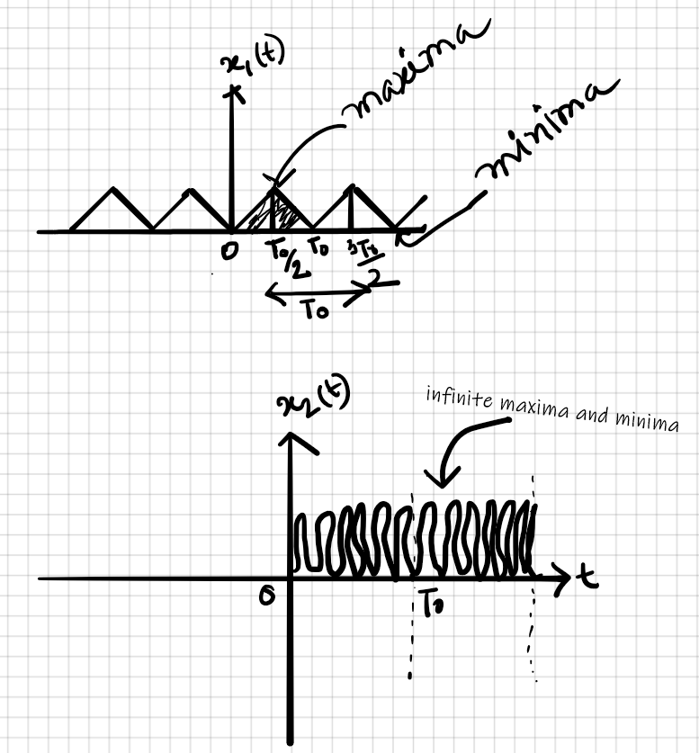
Dirichlet Condition 1
Both signal x₁(t) and x₂(t) are periodic.
For x₁(t), fundamental period is T₀. We can see one minima and one maxima within FTP, i.e. condition 1 satisfied.
For x₂(t), we can see infinite numbers of maxima and minima within FTP, i.e. condition 1 not satisfied. So we can not find FS expansion for x₂(t).

Slide 6
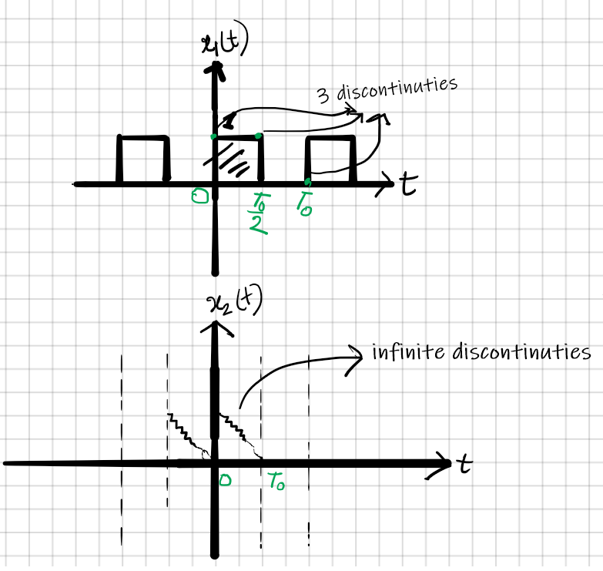
Condition 2
For x₁(t), fundamental period is T₀, there are 3 discontinuities, i.e. finite numbers of discontinuities within FTP.
Finally, we can say FS exists for x₁(t).
For x₂(t), fundamental period is T₀ and we can infinite number of discontinuities over FTP.
There is no FS expansion for x₂(t)

Slide 7
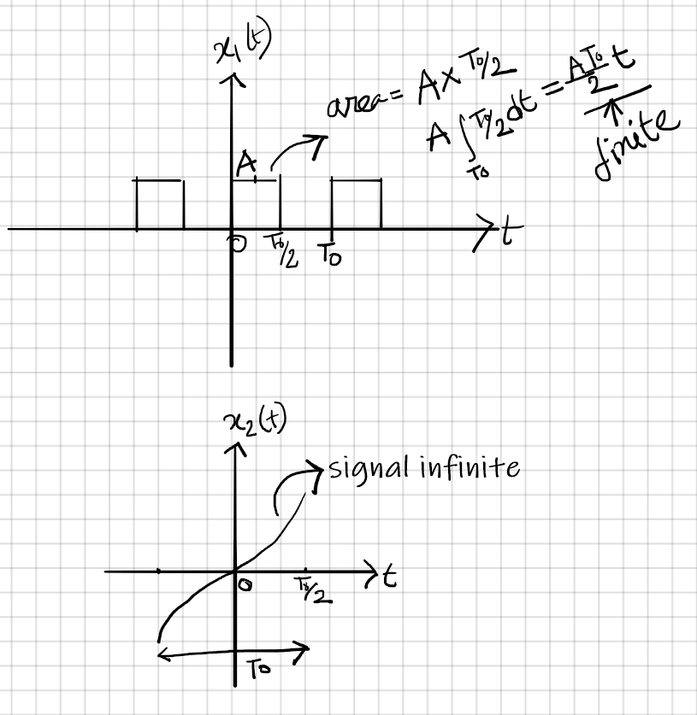
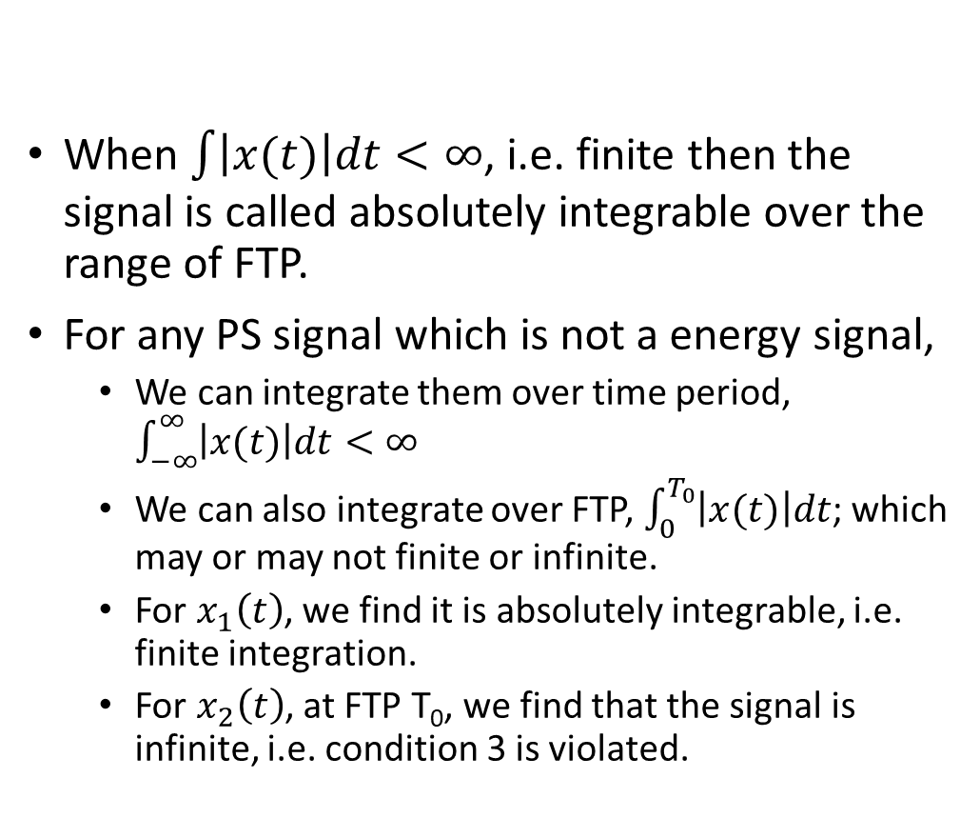
Condition 3
When $\int{\left|x(t)\right|dt<∞}$, i.e. finite then the signal is called absolutely integrable over the range of FTP.
For any PS signal which is not a energy signal,
We can integrate them over time period, $\int_{−∞}^{∞}{\left|x(t)\right|dt<∞}$
We can also integrate over FTP, $\int_{0}^{T_{0}}{\left|x(t)\right|dt}$; which may or may not finite or infinite.
For $x_{1}\left(t\right)$, we find it is absolutely integrable, i.e. finite integration.
For $x_{2}\left(t\right)$, at FTP T₀, we find that the signal is infinite, i.e. condition 3 is violated.

Slide 8
Periodic Signals
A continuous-time signal x(t) to be periodic if there is a positive nonzero value of T for which
x(t + T) = x(t) ;all t
The fundamental period T₀ of x(t) is the smallest positive value of T and 1/T₀ = f ₀ is referred to as the fundamental frequency.

Slide 9
Complex Exponential Fourier Series Representation
The complex exponential Fourier series representation of a periodic signal x( t) with fundamental period T₀ is given by
where c_{k} are known as the complex Fourier coefficients and are given by
where ∫_{To} denotes the integral over any one period and 0 to C or -T₀/2 to T₀/2 is commonly used for the integration. Setting k = 0
which indicates that c₀ equals the average value of x(t) over a period.

Slide 10
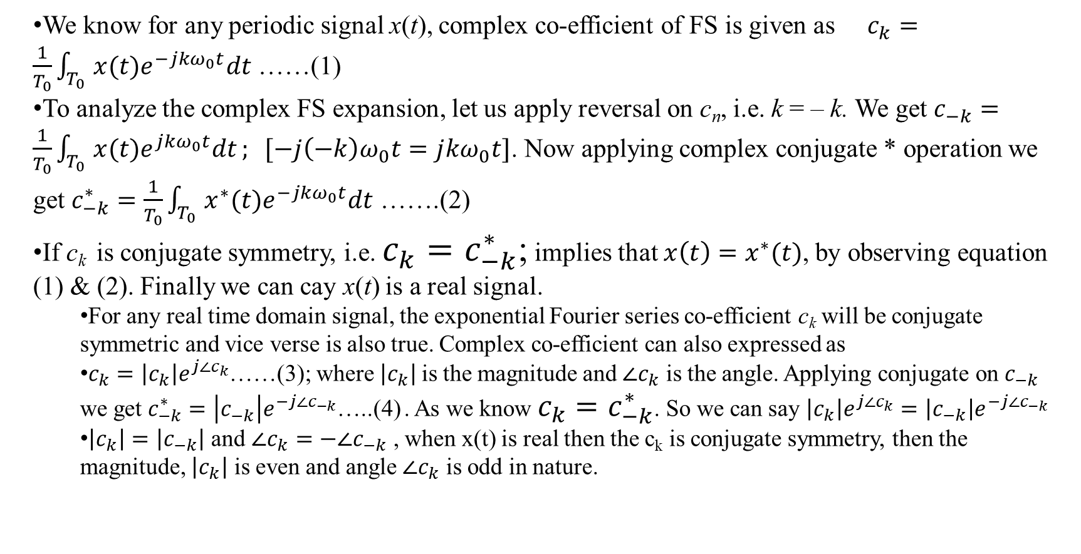
Complex Exponential Fourier Series Representation
We know for any periodic signal x(t), complex co-efficient of FS is given as $c_{k}=\frac{1}{T_{0}}\int_{T_{0}}{x(t)e^{−jkω_{0}t}dt}$ ……(1)
To analyze the complex FS expansion, let us apply reversal on c_{n}, i.e. k = ‒ k. We get $c_{−k}=\frac{1}{T_{0}}\int_{T_{0}}{x(t)e^{jkω_{0}t}dt}; [−j{\left(−k\right)ω}_{0}t=j{kω}_{0}t]$. Now applying complex conjugate * operation we get $c_{−k}^{∗}=\frac{1}{T_{0}}\int_{T_{0}}{x^{∗}(t)e^{−jkω_{0}t}dt}$ …….(2)
If c_{k} is conjugate symmetry, i.e. $c_{k}=c_{−k}^{∗}$; implies that $x\left(t\right)=x^{∗}(t)$, by observing equation (1) & (2). Finally we can cay x(t) is a real signal.
For any real time domain signal, the exponential Fourier series co-efficient c_{k} will be conjugate symmetric and vice verse is also true. Complex co-efficient can also expressed as
$c_{k}=\left|c_{k}\right|e^{j∠c_{k}}$……(3); where $\left|c_{k}\right|$is the magnitude and $∠c_{k}$ is the angle. Applying conjugate on $c_{−k}$ we get $c_{−k}^{∗}=\left|c_{−k}^{}\right|e^{−j∠c_{−k}}$…..(4) . As we know $c_{k}=c_{−k}^{∗}$. So we can say $\left|c_{k}\right|e^{j∠c_{k}}=\left|c_{−k}\right|e^{−j∠c_{−k}}$
$\left|c_{k}\right|=\left|c_{−k}\right|$ and $∠c_{k}=−∠c_{−k}$ , when x(t) is real then the c_{k} is conjugate symmetry, then the magnitude, $\left|c_{k}\right|$ is even and angle $∠c_{k}$ is odd in nature.

Slide 11
Trigonometric Fourier Series
The trigonometric Fourier series representation of a periodic signal x(t) with fundamental period T₀ is given by
x(t) = dc/avg. values of x(t)+ cosine terms + sine terms
where a_{k} and b_{k} are the Fourier coefficients and the complex Fourier coefficients c_{k} given by

Slide 12
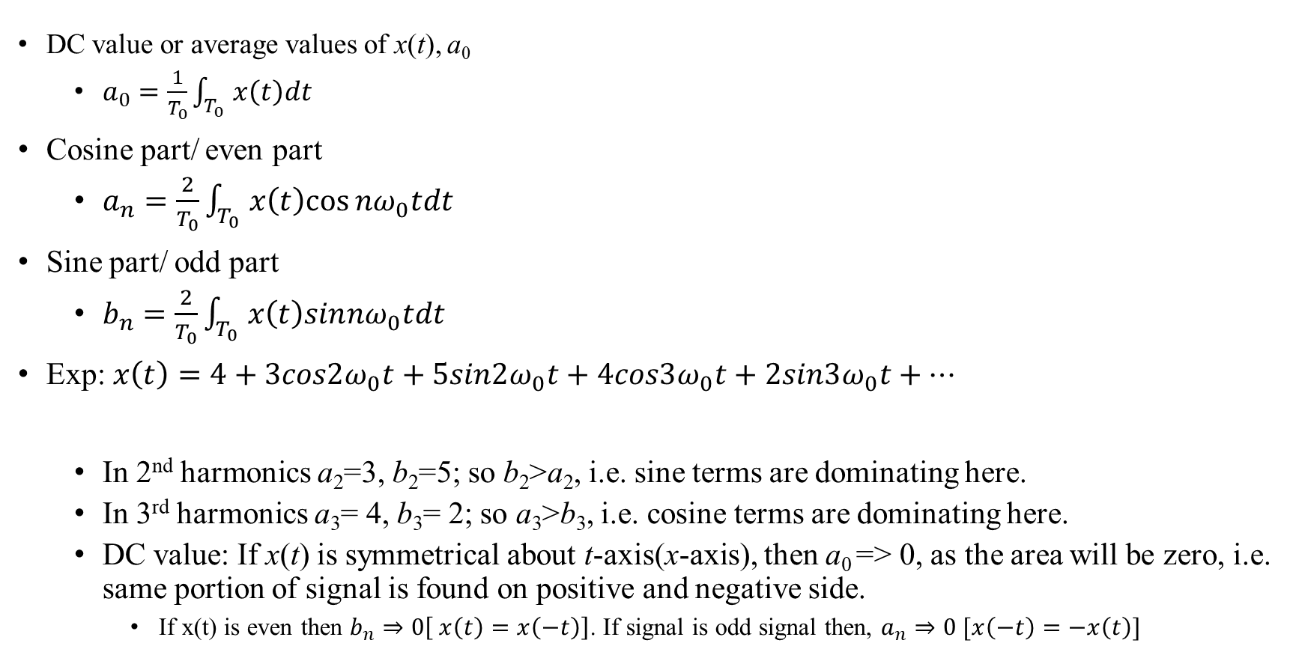
Coefficients of Trigonometric Fourier Series
DC value or average values of x(t), a₀
$a_{0}=\frac{1}{T_{0}}\int_{T_{0}}{x\left(t\right)dt}$
Cosine part/ even part
$a_{n}=\frac{2}{T_{0}}\int_{T_{0}}{x\left(t\right)cos⁡nω_{0}tdt}$
Sine part/ odd part
$b_{n}=\frac{2}{T_{0}}\int_{T_{0}}{x\left(t\right)sin{nω}_{0}tdt}$
Exp: $x\left(t\right)=4+3cos2ω_{0}t+5sin2ω_{0}t+4cos3ω_{0}t+2sin3ω_{0}t+…$
In 2nd harmonics a₂=3, b₂=5; so b₂>a₂, i.e. sine terms are dominating here.
In 3rd harmonics a₃= 4, b₃= 2; so a₃>b₃, i.e. cosine terms are dominating here.
DC value: If x(t) is symmetrical about t-axis(x-axis), then a₀ => 0, as the area will be zero, i.e. same portion of signal is found on positive and negative side.
If x(t) is even then $b_{n}⇒0\left[ x\left(t\right)=x\left(−t\right)\right]$. If signal is odd signal then, $a_{n}⇒0 [x\left(−t\right)=−x\left(t\right)]$

Slide 13
Even and Odd Signals
If a periodic signal x(t) is even, then b_{k}= 0 and its Fourier series contains only cosine terms:
If x(t) is odd, then a_{k} = 0 and its Fourier series contains only sine terms

Slide 14
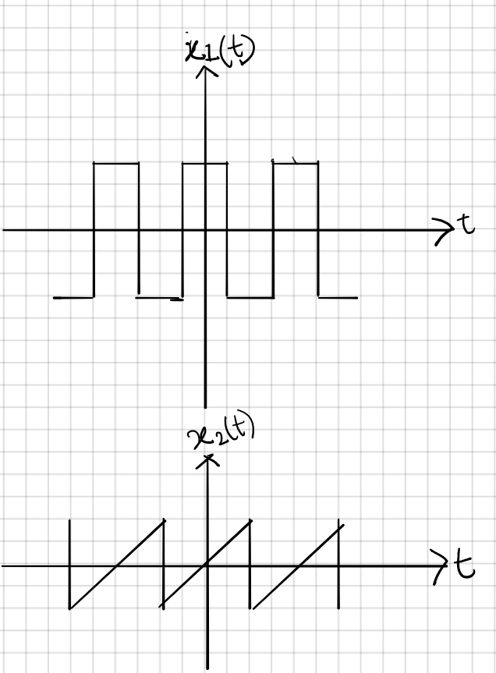
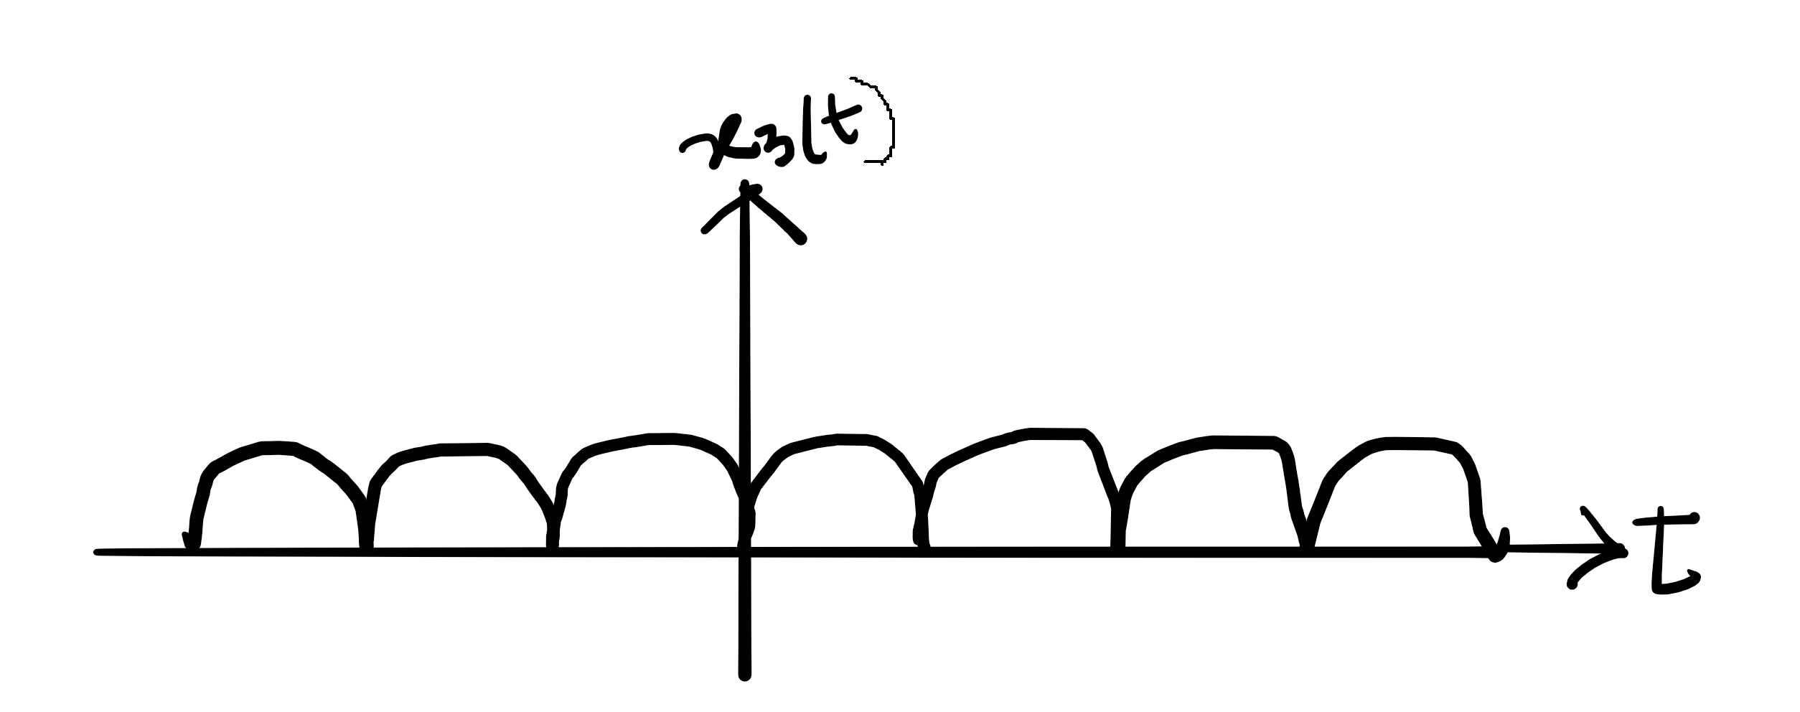
Example
For x₁(t)
The signal is symmetrical about x- axis, so a₀= 0
Again, x₁(t) is even signal, so b_{n}= 0.
Only a_{n}≠ 0, we need to calculate this part to expand the signal.
For x₂(t)
Again avg. value a₀= 0
The signal is odd so a_{n}= 0
Only need to find the part b_{n}≠ 0

Slide 15
Harmonic Form Fourier Series
Another form of the Fourier series representation of a real periodic signal x(t) with fundamental period T₀ is
The term C₀ is known as the de component, and the term C_{k}cos(kw₀t - (θ_{k}) is referred to as the kth harmonic component of x(t). The first harmonic component C₁ cos(w₀t - θ₁) is commonly called the fundamental component because it has the same fundamental period as x(t). The coefficients C_{k} and the angles θ_{k} are called the harmonic amplitudes and phase angles, respectively, and they are related to the Fourier coefficients a_{k} and b_{k} by

Slide 16
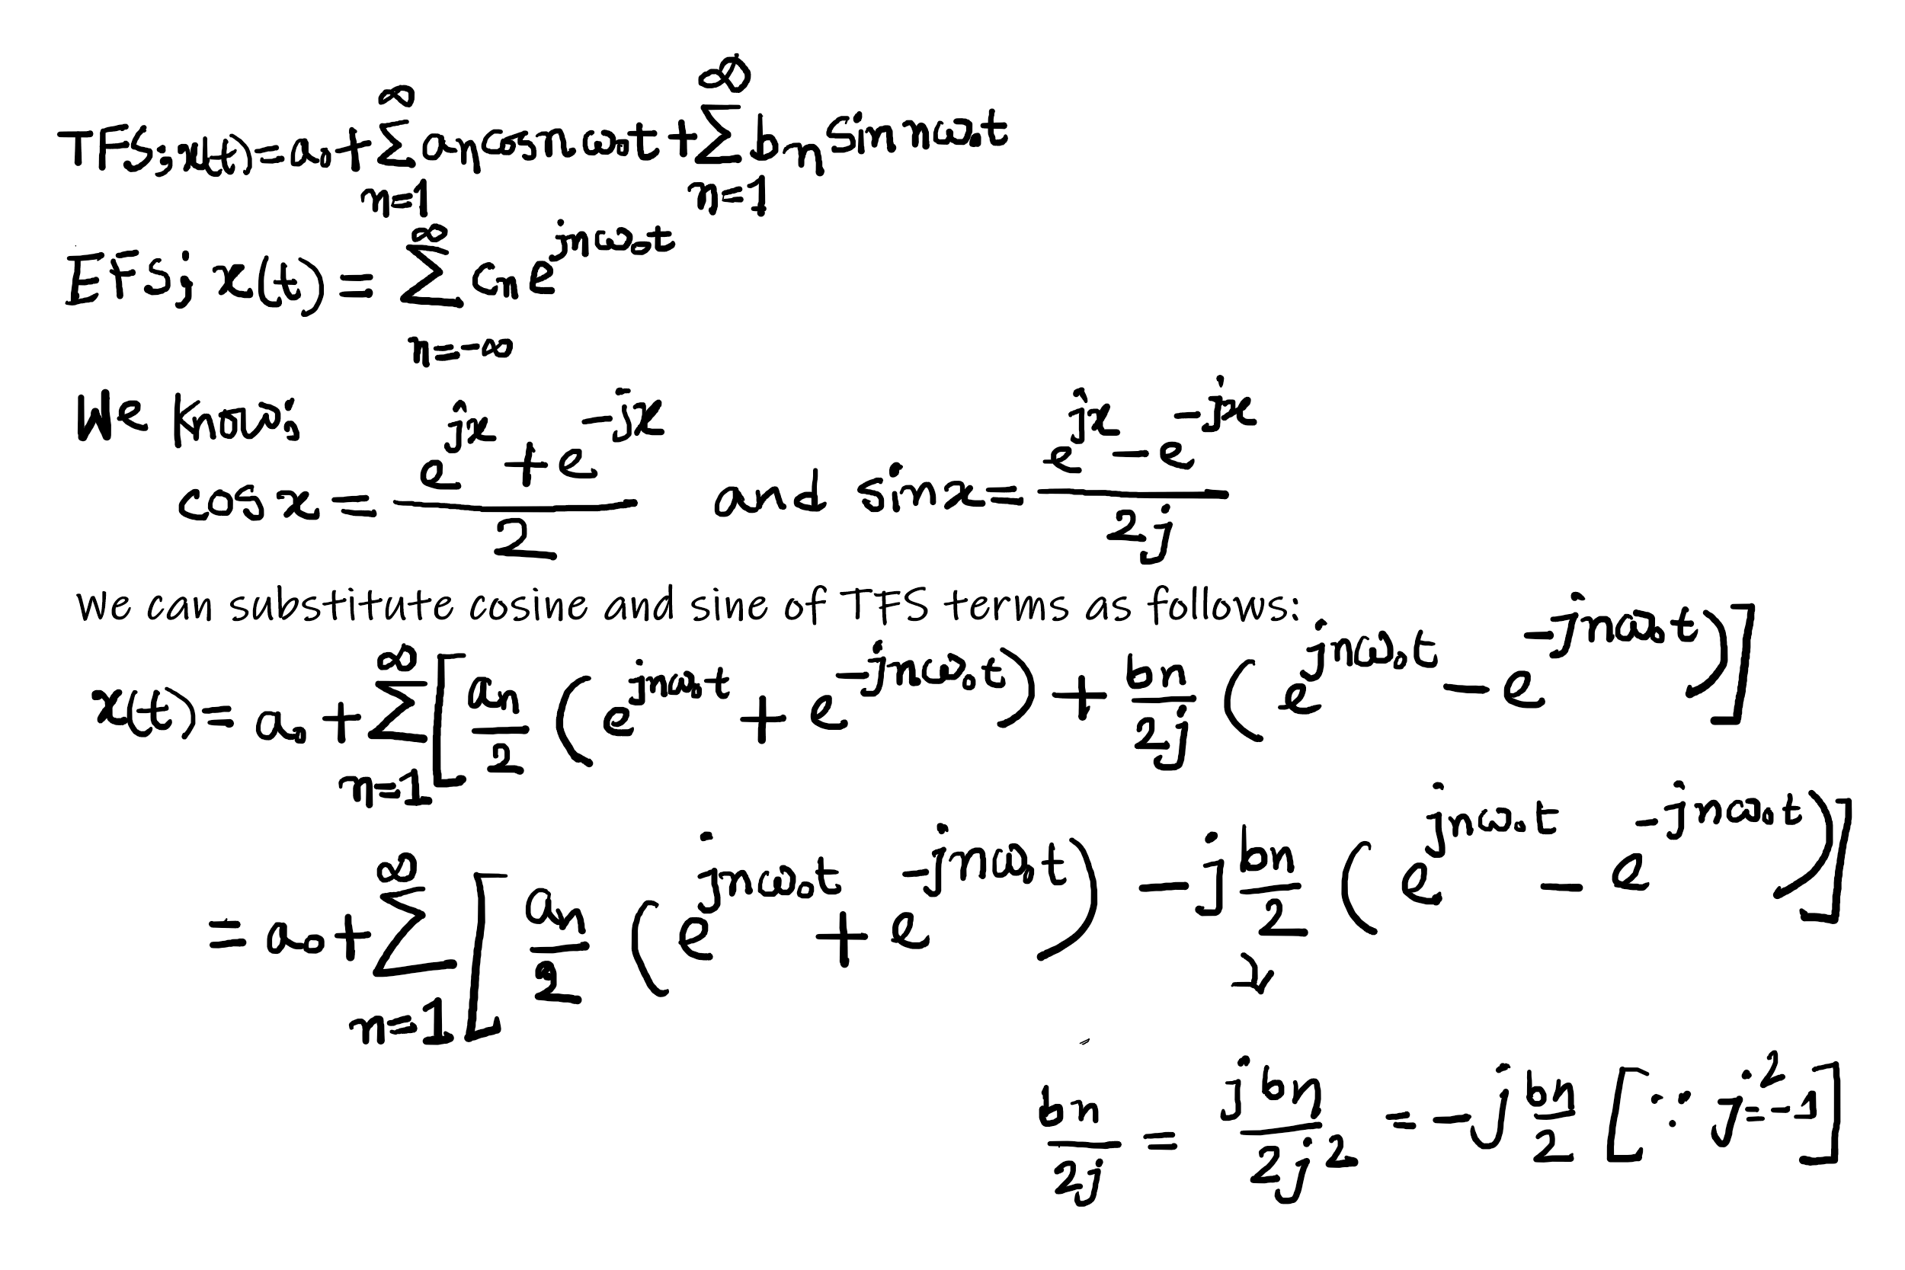
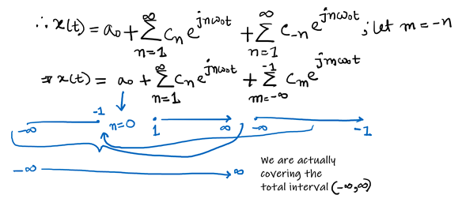
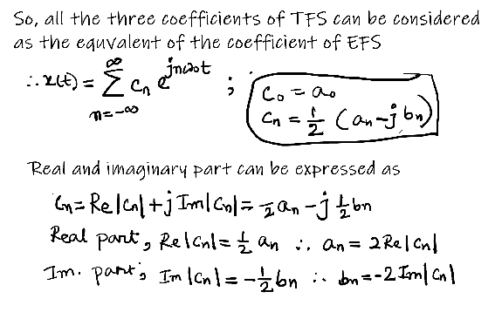
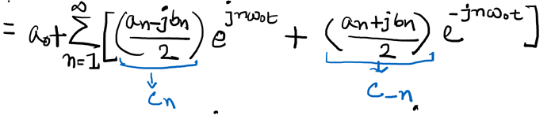
Relation between the coefficients of TFS and EFS

Slide 17
The Fourier Transform
Spectrum of any nonperiodic signal is analyzed by Fourier transform/integral instead of Fourier series. Let us now consider a nonperiodic signal x(t), its Fourier integral/transform is expressed as,
Again its inverse Fourier transform is given as,
Symbolically we can write, x(t) ↔ X(f)
That is we can convert signals from time to frequency domain and vice-varsa.

Slide 18
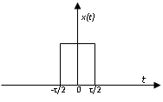
The Fourier Transform of rectangular pulse
Let us consider a rectangular pulse of width τ and height A shown in fig.
Fourier transform of x(t),

Slide 19

Inverse Fourier Transform
Let X(ω) be the Fourier transform of an integrable continuous-time signal x(t).
Under suitable condition, x(t) can be reconstructed from X(ω) using inverse Fourier transform , as:

Slide 20
Properties of Fourier transform
Let x(t), x₁(t), x₂(t) and x₃(t) be four integrable continuous-time signals and their Fourier transforms are X(ω), X₁(ω), X₂(ω) and X₃(ω) respectively.
The Fourier transform has the following basic properties:
Linearity:
For any complex numbers a and b,
a x₁(t) + b x₂(t) ←→ a X₁(ω) + b X₂(ω)

Slide 21

Properties of Fourier transform
Time-shifting (Translation):
For any real numbers t₀, the time shift version of signal x(t) to t_{o} is x(t-t₀). Then
Equation (5.50) shows that the effect of a shift in the time domain is simply to add a linear term –ωt₀ to the original phase spectrum θ(ω). This is known as a linear phase shift of the Fourier transform X(ω).
Thus, time-shifting property shows that the multiplication of Fourier transform X(ω) of signal x(t) by a complex exponential signal e^{j ω}₀^{t} is equal to the t₀ shift of x(t) in time domain.

Slide 22
Properties of Fourier transform
Frequency-shifting (Modulation):
For any real numbers ω₀, if x(t) = e^{j ω}₀^{t} x₁(t), then X(ω) = X₁(ω -ω₀).
The multiplication of x₁(t) by a complex exponential signal e^{j ω}₀^{t} is sometimes called complex modulation.
Thus, frequency-shifting property shows that complex modulation in the time domain corresponds to a shift of X(w) in the frequency domain.
Note that the frequency-shifting property is the dual of the time-shifting property.

Slide 23
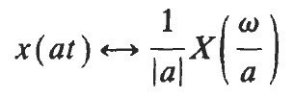
Properties of Fourier transform
Time Scaling:
For a non-zero real number a, the time scale version of signal x(t) is x(at), then
The above equation indicates that scaling the time variable t by the factor a causes an inverse scaling of the frequency variable ω by 1/a, as well as an amplitude scaling of X(ω/a) by 1/|a|.
Thus, the scaling property implies that time compression of a signal (a>1) results in its spectral expansion and that time expansion of the signal (a<1) results in its spectral compression.

Slide 24

Properties of Fourier transform
Time Reversal:
If time reversal of signal x(t) in time domain is x(-t), then in frequency domain the like reversal of X(ω) is X(- ω). That is
x(-t)←→X(- ω)
In time-scaling property, the case a = -1 leads to the time-reversal property.
Convolution Property:
The above equation is referred to as the time convolution theorem, and it states that convolution in the time domain becomes multiplication in the frequency domain.

Slide 25

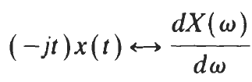
Properties of Fourier transform
Differentiation in the Time Domain:
The above equation shows that the effect of differentiation in the time domain is the is the multiplication of X(ω) by jω in the frequency domain.
Differentiation in the Frequency Domain:
Thus we see that, differentiation in the frequency domain property is the dual of differentiation in the time domain.

Slide 26

Properties of Fourier transform
Multiplication:
The multiplication property is the dual property of convolution property.
This property is often referred to as the frequency convolution theorem.
Thus, multiplication in the time domain becomes convolution in the frequency domain.

Slide 27
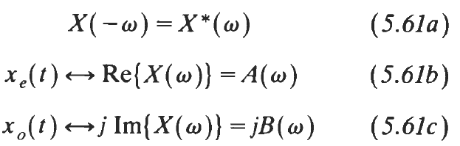
Properties of Fourier transform
Additional Property:
If x(t) is real, then it can be expressed as the sum of its even and odd components, i.e., x(t) = x_{e}(t)+x_{o}(t).
Let, x(t)←→ X(ω) + A(ω) +jB(ω).
Then
Equation (5.61a) is the necessary and sufficient condition for x(t) to be real.
Equations (5.61b) and (5.61c) show that the Fourier transform of an even signal is a real function of ω and that the Fourier transform of an odd signal is a pure imaginary function of ω .

Slide 28
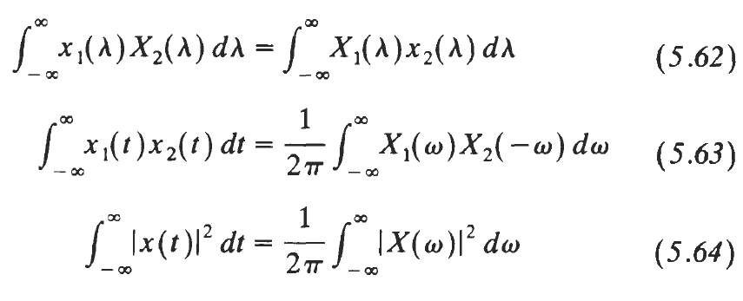
Parseval’s Property:
Equation (5.64) is called Parseval's identity (or Parseval's theorem) for the Fourier transform.
Note that the quantity on the left-hand side of Eq. (5.64) is the normalized energy content E of x(t). Parseval's identity says that this energy content E can be computed by integrating |X(ω)|² over all frequencies ω. For this reason |X(ω)|² is often referred to as the energy-density spectrum of x(t), and Eq. (5.64) is also known as the energy theorem. of ω .

